Slide 1
Title: Startup Investment Analysis using Shark Tank Data
Subtitle: Insights Investment Wise Trends
Name : KURVA UMESH
Tools Used: Excel, Python, Tableau
Date: JUNE 2025

Slide 2
2. Objective
This project aims to analyze startup investment trends using Shark Tank datasets to uncover industry-wise investment patterns, founder success traits, and investor preferences.
3. Methodology
Dataset Source: [e.g., Kaggle – Shark Tank India Dataset]
Tools: Excel (for cleaning), Tableau (for visualization)
Steps:
1.
Cleaned data (industry, funding, founders, investors)

Slide 3
2. Analyzed domain-wise and investor trends
3. Built interactive Tableau visuals
Key Findings
A.Industry Trends
Top 3 funded industries: [e.g., Food & Beverage, Health, Tech] Sectors with highest average deal size
Founder Patterns
Co-founded startups received more deals than solo founders Gender (if available) had influence on deal success
Funding Stage Insights
Most deals occurred in [Seed] stage
Series A/B had fewer but higher-value deals
Investor Behavior
Most active investors: [e.g., Aman, Peyush]

Slide 4
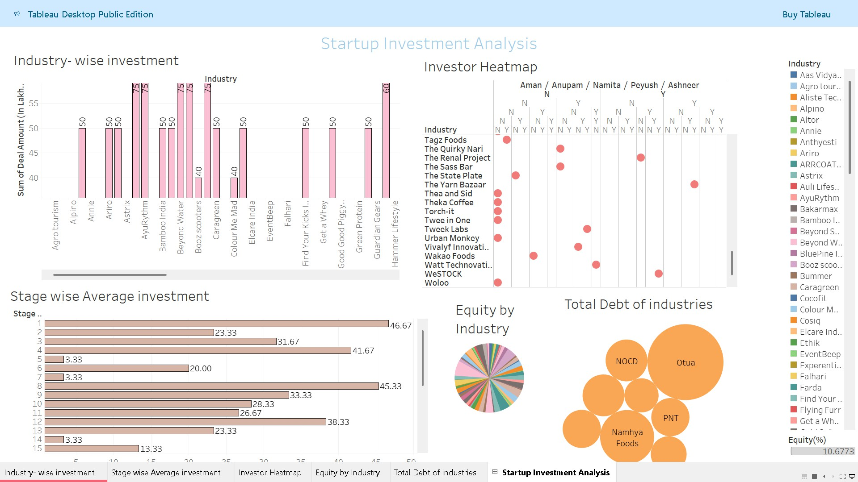
5. Visual Dashboard

Slide 5
6. Conclusion & Recommendations
Investors heavily favor certain industries entrepreneurs should align with those
Co-founders and clearly defined pitches result in higher success Certain sharks have preferences; align pitch accordingly

